Slide 1

Healthcare Accessibility Analysis
Delhi National Capital Territory
Evidence-based assessment of healthcare infrastructure coverage and underserved populations across Delhi NCT using GIS spatial analysis.

Slide 2

Study Overview
Study Area
Delhi NCT, India
1,484 km² area
Population
19,435,508 residents
WorldPop 2020 estimate
Healthcare Facilities
495 hospitals analyzed
OpenStreetMap data
Analysis Method
5km Euclidean buffer
GIS spatial assessment

Slide 3

Data Sources & Processing
Key Datasets
Processing Steps
Administrative boundaries from GADM v4.1
Reprojected to UTM Zone 43N for accurate distance calculations
Hospital locations via OpenStreetMap (QuickOSM)
Clipped datasets to Delhi boundary
Population density from WorldPop (1km resolution)
Removed 5 hospitals outside official boundary
Road network from OpenStreetMap
Resampled population raster using bilinear interpolation

Slide 4
Analysis Methodology
01
02
Service Area Creation
Gap Identification
Created 5km buffers around each hospital location and dissolved overlapping areas to create continuous coverage zones.
Used difference geoprocessing to identify areas beyond 5km from any hospital, resulting in 4 underserved zones.
03
04
Population Quantification
Priority Assessment
Clipped population raster to underserved areas and calculated zonal statistics to determine affected populations.
Ranked zones by population density as a proxy for urgency, identifying high-priority intervention areas.

Slide 5

Overall Coverage Results
97.83%
422K
495
Population Coverage
Underserved Population
Healthcare Facilities
19,013,068 residents within 5km of a hospital
422,440 people beyond 5km access (2.17%)
Approximately 1 hospital per 39,000 residents
Delhi's healthcare infrastructure exceeds WHO urban access recommendations of 80%, demonstrating strong spatial coverage across the territory.

Slide 6
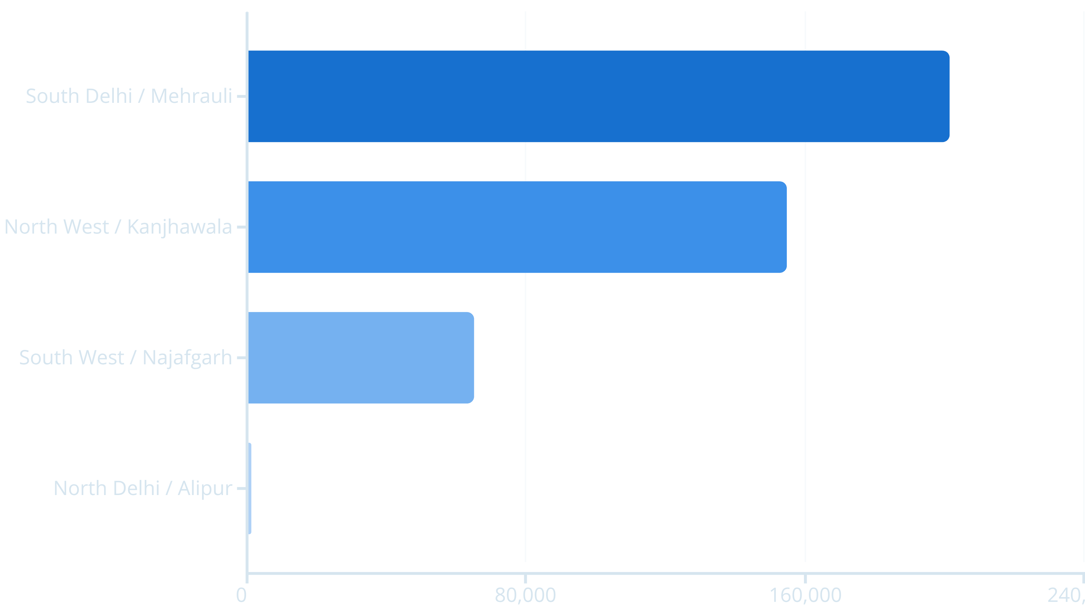
Identified Gap Zones
Four underserved areas identified in peripheral districts, ranked by population density and priority level.

Slide 7
Priority Zone Details
1
2
Mehrauli Tehsil (South Delhi)
Kanjhawala Tehsil (North-West)
Population: 201,339 | Area: 52.2 km²
Population: 154,931 | Area: 50.2 km²
Density: 3,857 per km² | Priority: HIGH
Density: 3,084 per km² | Priority: HIGH
3
4
Najafgarh Subdivision (South-West)
Alipur Subdivision (North)
Population: 64,966 | Area: 40.9 km²
Population: 1,204 | Area: 2.3 km²
Density: 1,589 per km² | Priority: MEDIUM
Density: 523 per km² | Priority: LOW

Slide 8

Strategic Recommendations
1
Immediate Action (0-2 years)
Establish 200-bed multi-specialty hospital in Mehrauli Tehsil serving 201,339 residents.
Establish 150-bed district hospital in Kanjhawala Tehsil serving 154,931 residents.
2
Medium-Term Planning (2-5 years)
Upgrade existing primary health center or establish 50-bed community hospital in Najafgarh Subdivision.
Monitor population growth in Alipur; consider mobile health unit deployment.

Slide 9



Expected Impact
99%
Coverage Increase
Implementation of priority recommendations
356K
Beneficiaries
Currently underserved residents served
Estimated Investment: ₹300-500 crores for two priority facilities

Slide 10

Key Findings
Delhi's healthcare infrastructure demonstrates strong spatial coverage (97.83%), exceeding international urban access benchmarks. Priority interventions in Mehrauli and Kanjhawala tehsils could serve 356,270 underserved residents, improving coverage to >99%.
Strong Foundation
Targeted Gaps
Evidence-Based Planning
Current coverage exceeds WHO recommendations
422,440 residents in 4 peripheral zones identified
GIS analysis enables strategic resource allocation
Analysis conducted: November 2025 | Analyst: Tanish | Project: Urban Infrastructure Accessibility Assessment - Delhi NCT

